Slide 1

IDS2: RASD presentation
Alessandro Macchi
Caterina Finetti
Simone Manzoli

Slide 2
Glossary
User: is a person who is registered in the database of the application. He has acces to all the functions of the program that involves the requiring of a taxi, shared or not. He also has the possibility to save a list of preferred locations, that he can automatically choose when the System require from him an adressas starting position or destination.
Guest: is a person who is using the application but is not registered in the database. He has acces only to the registration functions.
User Information: all the information that concern a user; most of them have to be inserted during the registration (Name, Surname, tel. Number, email, password), some of them can be inserted at any time after the registration (such as the personals locations) and others are assigned by the system (for example the number of blank-calls).
Basic User Information
Blank Call: we define Blank-call a call for a taxi where the client is not at the starting location when the taxi arrives with a maximum late of 10 minutes, or a call that the user cancel before 10 minutes.
Missed Call: we define Missed-call a call for a taxi where the client is not at the starting location when the taxi arrives (10+1) or more minutes late.
Partner: someone who share a run with a user
Pick-up place: the Adress where a user asks a taxi to come
Taxi Driver: a registered one

Slide 3
Goals
A user should be able to:
sign up to the system (starting as a guest)
log in to the system
call for a taxi that should pick him up ASAP
be informed by the system when a taxi driver accepts his call and of the estimated waiting time
make a reservation for a taxi on specified date and time
give his availability for sharing a run
add, modify or delete a personal location
A taxi driver should be able to:
accept or decline a call
visualize the basic information about the user who is making a call
visualize the price for a run
The system should provide a fair management of the calls and efficient and essential communication between drivers and users.

Slide 4
Domain proprierties
Assumptions
• A taxi can always reach a pick-up place and the users can only choose destinations reachable
• A zone can't remain without at least one available taxi
• A taxi driver that accepts a call will take it
• Gps information and maps are always updated
• Two or more users can share a taxi only if their pick up place are in the same zone.
• The taxi drivers have a device on-board to communicate with the system, that shows them the incoming calls and permits them to accept or refuse.
• Every taxi has a gps-signal that can always give their position to the system

Slide 5
Requirements
Registration of a person to the system
the system has to provide a sign up functionality
Modification of personal information
the system has to provide a function that allows a user to modify his personal information, except for the number of calls and blank calls
Call for a taxi
the system has to provide a function to call for a taxi
the user should be able to visualize the estimated arrival time and confirm or not his call
the system has to manage the number of calls and blank calls of every user
Make a reservation for a taxi to a specified date and time
the system has to provide a function to allow a user to call for a taxi in a specified date and time
the system has to call for the taxi 10 minutes before the specified time
Give is availability for sharing a run
the system has to provide a function to allow a user to declare his availability for a taxi sharing
the system has to search for other users in the same zone that want to share a ride, and automatically inform the interested users and the taxi driver; then, if they accepts, has to calculate the cost of the ride.
Create, modify delete personal location
the system must provide a function to allow a user to create a new personal location
the system has to provide a function to allow a user to modify a personal location
the system has to provide a function to allow a user to delete a personal location.
Visualization of ride information
the system has to provide a function that allows a user to visualize the information about his actual ride (basically the cost calculated by the taximeter)
Accept or decline a call
The system has to forward the calls to the first taxi of the queue
The system has to provide a function to allow a taxi driver to accept or decline a call when he receives it
If a call is d declined it at the end of the queue and send the call to the new first in the queue
Visualize the basic information about a user who is making a call
the system has to provide a function to allow a taxi driver to visualize the basic information of a user that is making a call
Signal a blank call
the system has to provide a function to allow a taxi driver to signal a blank call
the system has to put the taxi back in te queue and update the blank_call attribute of the user declined, the system has to move the taxi driver that

Slide 6
Functional requirements
Guest can
sign up
Taxi driver can
receive notifications for the calls
visualize the basic information of a user that is making a call
accept a call
decline a call
signal a blank call
User can
log in
log out
modify his personal information except for the number of calls and blank calls
create a new personal location
modify an existing personal location
delete an existing personal location
do an immediate call for a taxi (shared or not)
do a delayed call for a taxi
visualize the ride information

Slide 7
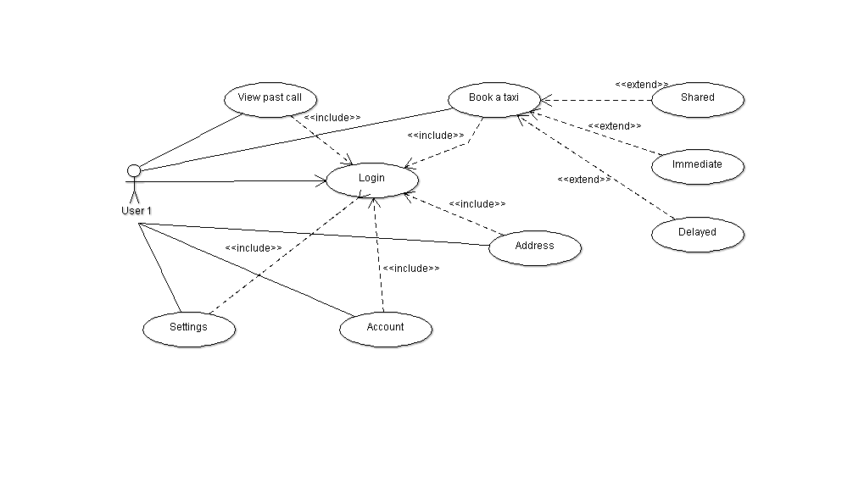
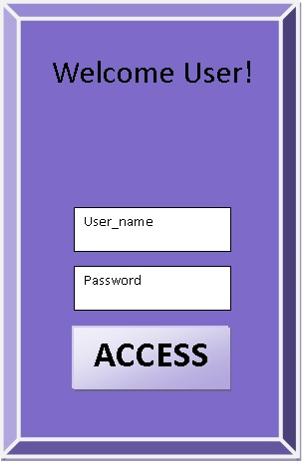
Login

Slide 8
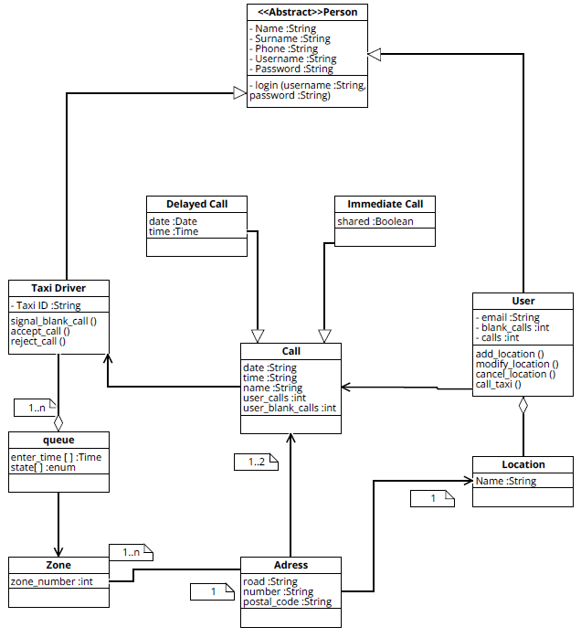
Class Diagram

Slide 9
Standard Call - Use Case
Name | Taxi request
Actors | User, Taxi Driver
Entry conditions | User have to be logged in and must be in the reservation page
Flow of events | The user request a taxi in his actual position The system send the request and the user's basic information to the first available taxi driver in the zone The taxi driver accepts the request. The system send to the user the expected waiting time and the code of the incoming taxi, and place the taxi driver in “waiting” state the user confirms the request within 1 minute the system removes the taxi driver form the queue and give to him/her confirmation The taxi driver goes to pick up the user and brings him/her to the destination. The taxi driver informs the system about his/her availability.
Exit conditions | The System put the taxi driver in the last position of his/her actual zone's queue
Exceptions | The taxi driver doesn't accept the call. In this case the system forwards the request to the second in the queue and move the first taxi in the last position in the queue. The user does not confirm his request after receiving notification of the expected arrival time. In this case the system put the taxi driver in “available” state. The user is not in the pick up place when the taxi arrives. See the dedicated use case.

Slide 10
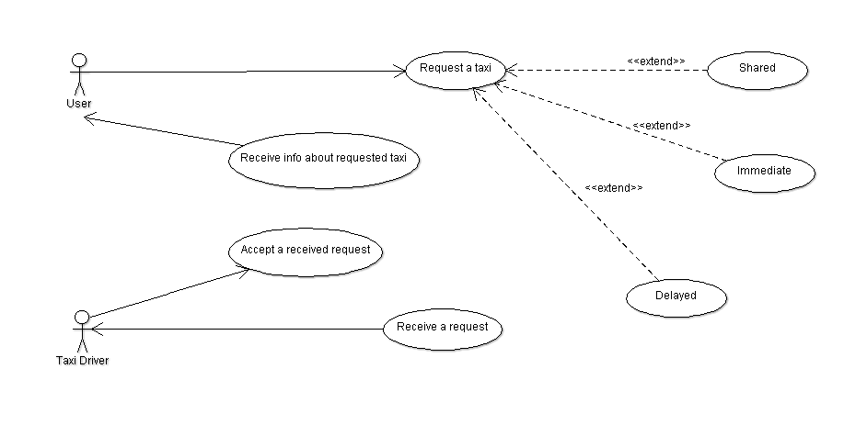
Standard Call – Use Case Diagram

Slide 11
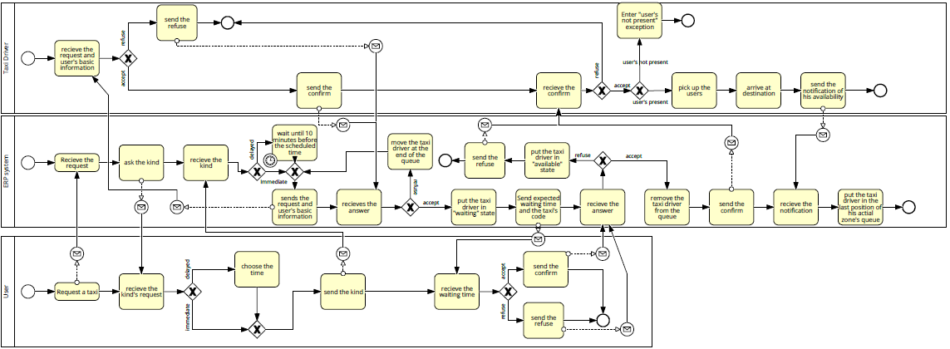
Standard Call - UML

Slide 12
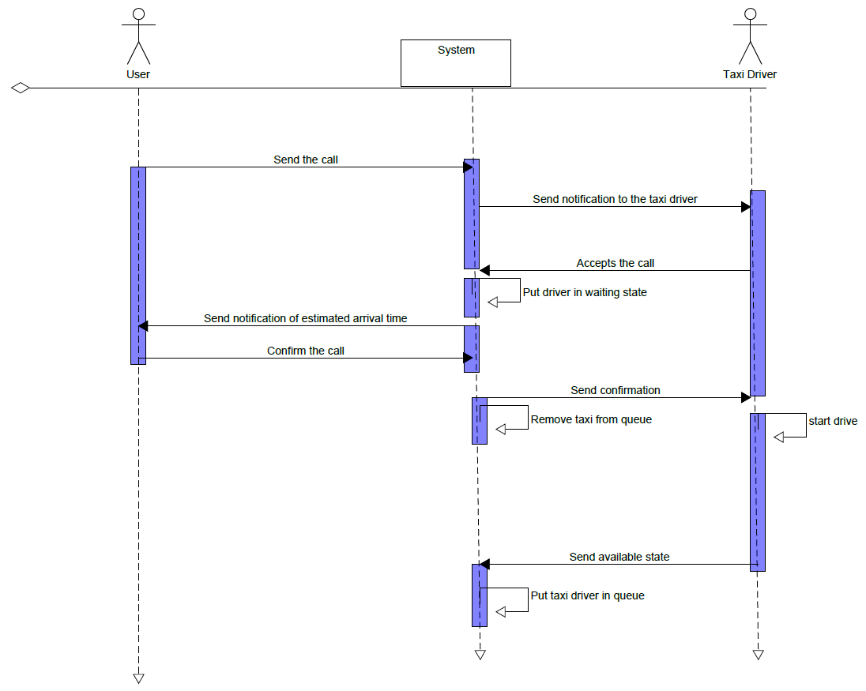
Standard Call – Sequence Diagram

Slide 13
Shared Call - Use Case
Name | Shared taxi request
Actors | Taxi Driver, user1, user2, user 3, taximeter
Entry conditions | User1, user 2 and user 3 have requests a taxi in the same zone, have the sharing option active and must to go in the same direction
Flow of events | The system sends a request with the users' basic information to the first available taxi driver in the zone The taxi driver accepts the request The system sends to the users the expected waiting time and the code of the incoming taxi, and places the taxi driver in "waiting" state The users confirm the request within 1 minute The system removes the taxi driver from the queue and gives him/her the confirmation The taxi driver goes to the pick up the users and bring the user 1 to his/her destination The taxi driver sends to the system the signal that taxi is arrived at the first destination The system reads the fee from the taximeter and divides it by the number of users in the taxi and saves the payed ammount The taxi arrives at the next destinations and the taxi driver sends to the system the signals that taxi is arrived The system reads the fee from the taximeter, subtracts the already payed ammount and divides the result by the number of users in the taxi The taxi driver informs the system about his/her availability.
Exit conditions | The System put the taxi driver in the last position of his/her actual zone's queue
Exceptions | The taxi driver doesn't accept the call. In this case the system forwards the request to the second in the queue and move the first taxi in the last position in the queue. One or more of the users but not all does not confirm his request after receiving notification of the expected arrival time. In this case the system notifies the taxi driver that that user refused the call All the users does not confirm the request after receiving notification of the expected arrival time. In this case the system put the taxi driver in “available” state. One or more users ar not at the pick up place when the taxi arrives. See the dedicated use case.

Slide 14
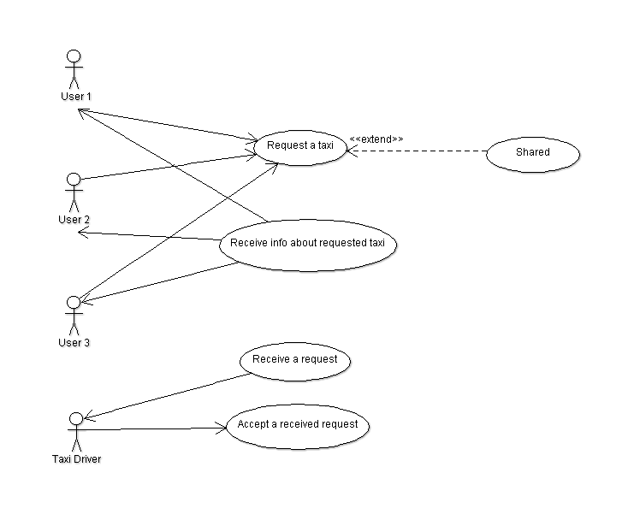
Shared Call – Use Case Diagram

Slide 15
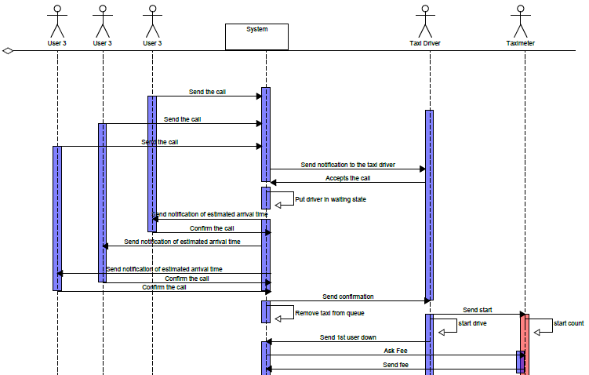
Shared Call – Sequence Diagram p.1

Slide 16
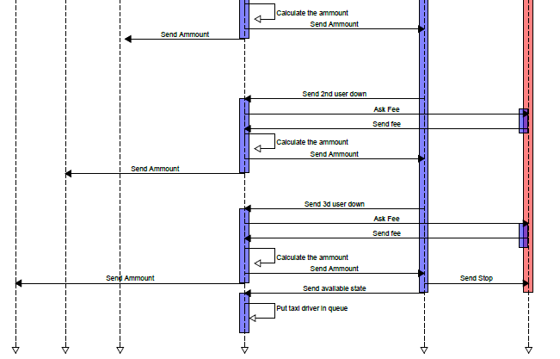
Shared Call – Sequence Diagram p.2

Slide 17
Other arguments
Delayed call
Management exception
Alloy in all cases
Test
The tools

